Slide 1

Airbnb's Recovery Strategy: New York City Market Analysis
Airbnb aims to revitalize its business post-COVID-19. This analysis of New York City listings provides insights to guide strategic decisions. We'll explore host performance, room preferences, pricing trends, and neighborhood popularity.
Presented by :
Sanjana Dadlani
Sarika Pande

Slide 2

Background: Airbnb's Pandemic Challenge
1
Revenue Decline
Airbnb experienced significant revenue loss during the pandemic due to travel restrictions.
2
Travel Resurgence
As restrictions lift, people are traveling again, presenting new opportunities for Airbnb.
3
Strategic Analysis
Airbnb conducted an in-depth analysis of New York City listings to inform recovery strategies.

Slide 3

Data Preparation Process
Data Cleaning
Removed missing values and duplicates to ensure data integrity and accuracy.
Feature Selection
Dropped insignificant columns to focus on the most relevant information.
Outlier Detection
Identified and addressed outliers to prevent skewed analysis results.

Slide 4
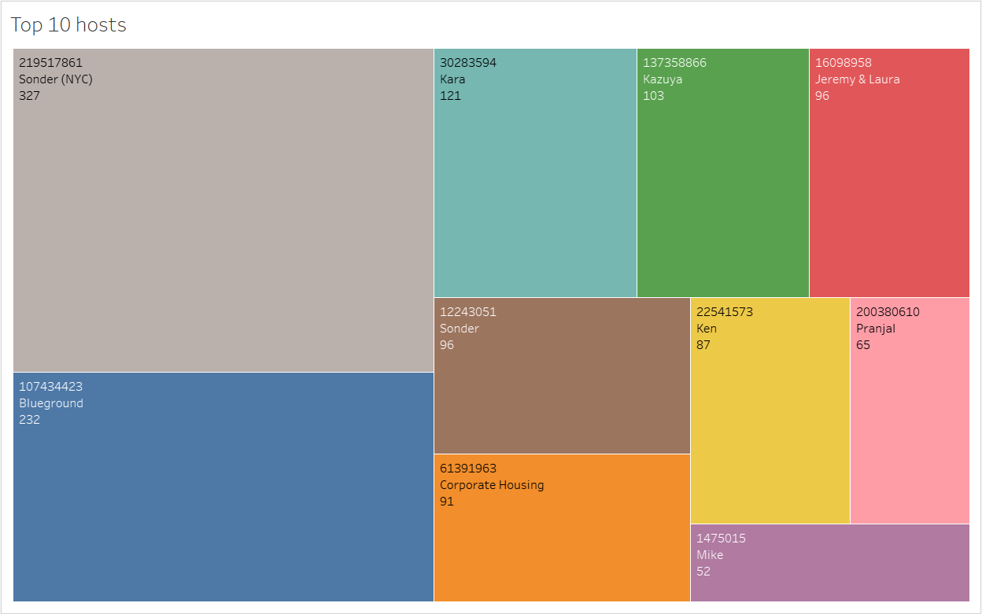
Top 10 Hosts Analysis
1
Top Performer
2
Runner-Up
Sonder (ID 219517861) leads with 327 bookings, showcasing exceptional market presence.
Blue Ground secures the second position, indicating strong competition in the market.
3
Individual Hosts
Kara, Ken, Pranjal, Jeremy, and Mike round out the top 10, representing successful individual hosts.

Slide 5
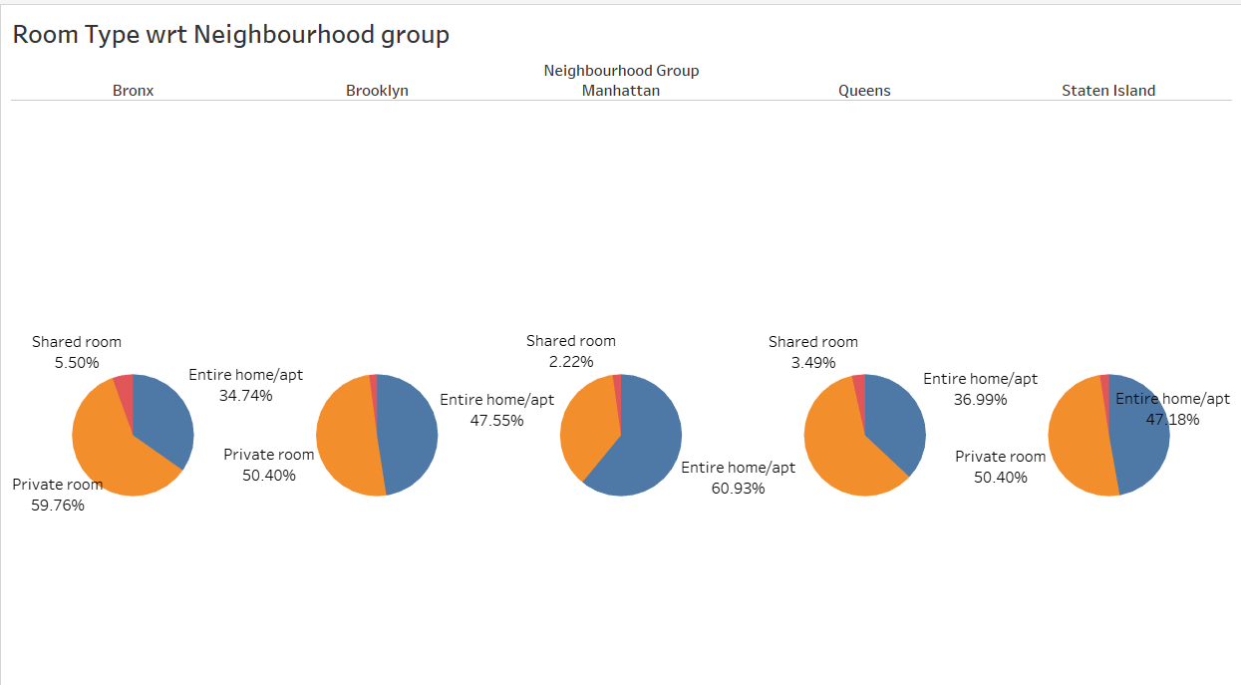
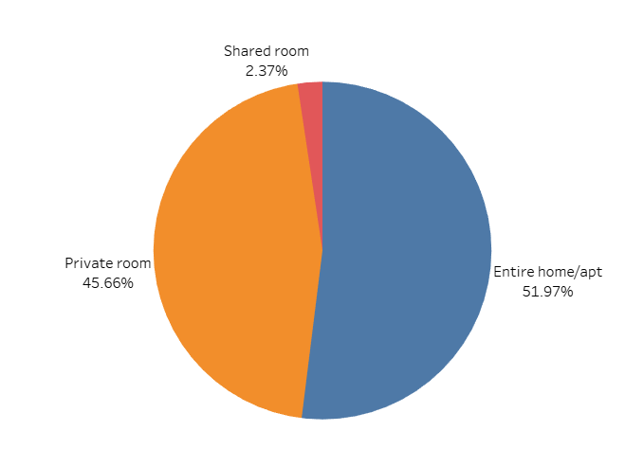
Room Type Preferences by Neighborhood
Overall Preferences
Neighborhood Trends
Strategic Opportunities
Private rooms (45%) and entire homes (52%) dominate customer choices. Shared rooms (2.4%) are less popular.
Queens and Bronx favor private rooms (60%). Manhattan leads in entire home rentals (61%).
Promote shared rooms with discounts. Acquire more private listings in high-demand areas.

Slide 6
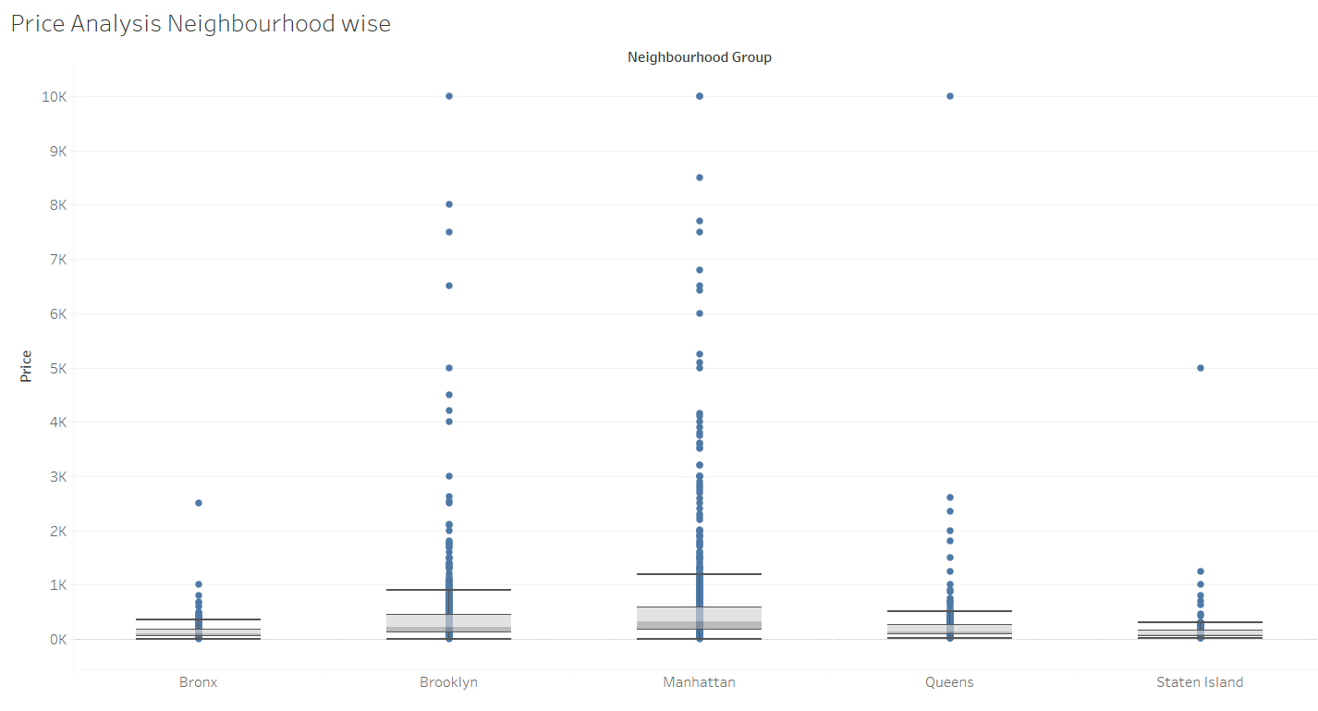
Price Analysis by Neighborhood
Neighborhood
Price Range
Key Observation
Manhattan
Highest
Most expensive listings
Brooklyn
High
Notable price outliers
Bronx
Lowest
Most affordable options

Slide 7
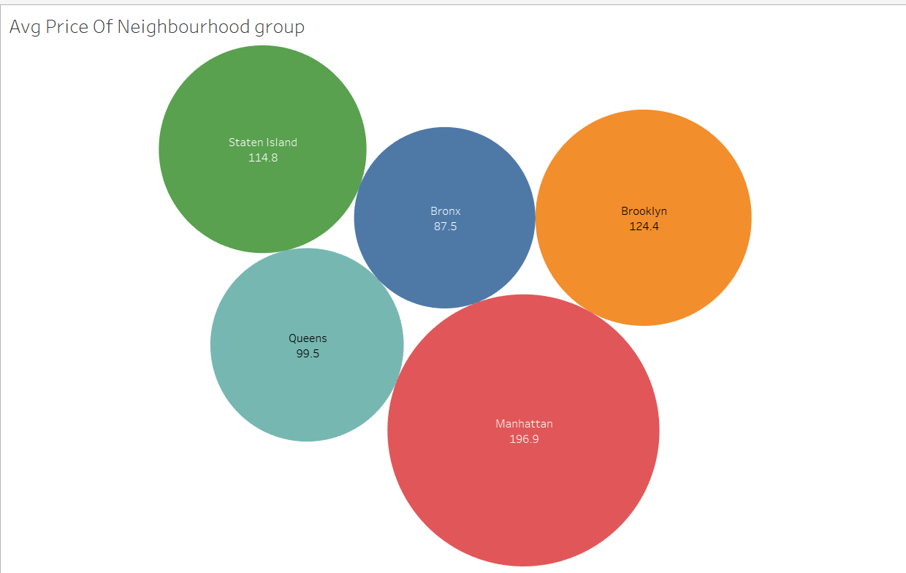
Average Prices Across Neighborhoods
Manhattan: $196.9
Brooklyn: $124.4
Bronx: ~$98
Highest average price, reflecting its prime location and amenities.
Second highest, balancing desirability with more affordable options.
Most affordable, offering budget-friendly alternatives for cost-conscious travelers.

Slide 8
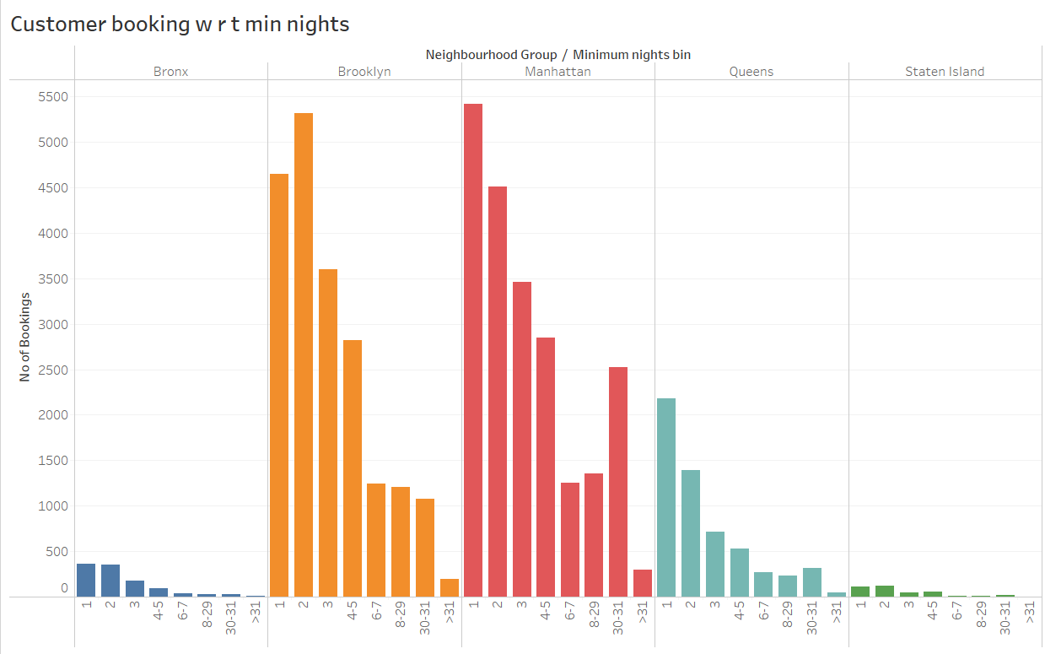



Booking Patterns and Minimum Nights
Short Stays Popular
1-5 night stays are most common, catering to weekend getaways and short trips.
Monthly Rentals Spike
30-day bookings show a notable increase, especially in Manhattan and Queens.
Business Travel Impact
Extended stays may indicate business travelers or temporary relocations.

Slide 9
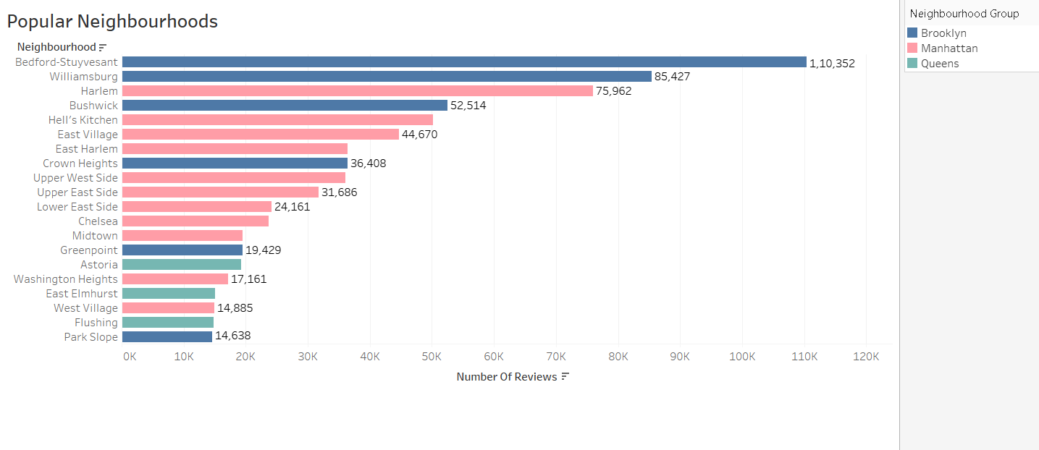
Popular Neighborhoods Analysis
1
Brooklyn's Hotspots
2
Manhattan's Favorites
Bedford-Stuyvesant leads with 110,352 reviews, followed closely by Williamsburg.
Harlem tops Manhattan's list, with Hell's Kitchen as a close second.
3
Customer Satisfaction
High review counts suggest greater guest satisfaction in these popular areas.

Slide 10
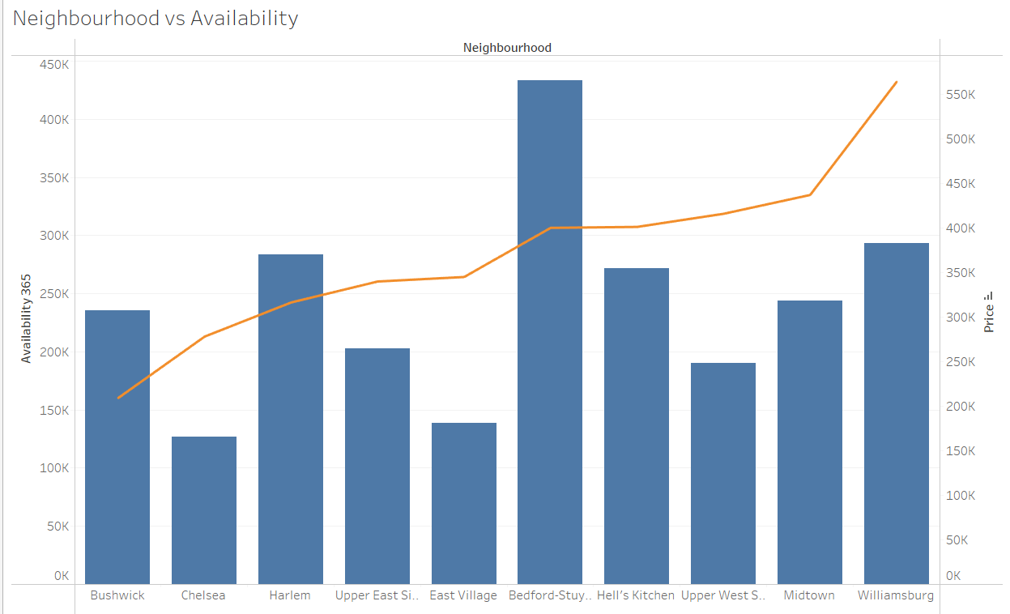
Neighborhood Availability vs. Price
Neighborhood
Availability
Price
Recommendation
Bedford
Highest
Low
Best value for customers
Harlem
High
Low
Good alternative to Bedford
Chelsea
Low
High
Premium, exclusive option

